Slide 1
Internship
Web Application Development
Koushik Chandra Sarker
2018000000024
Batch - 48
Supervisor
Mr. Rajon Bardhan
Lecturer & Coordinator
Department of CSE
Southeast University
Co-Supervisor
MD. Arafat Rahman
Senior Software Engineer
Inovace Technologies

Slide 2
Internship Site
Inovace Technologies
Inovace is one of the latest tech startups in Bangladesh, focusing on IT sector, especially on Embedded Systems Design and Software Development. It has a strong R&D team, who work on introducing new technologies and implementing new ideas.

Slide 3
There Main Activities And Product Lines
TIPSOI 21 GPRS
HRM(Human resource management)
INDUSTRIAL SOLUTION
Secondary Sales Visibility Solution
Contact Tracing Solution
Online Ticket Booking System
Number Of Employee: 80+

Slide 4
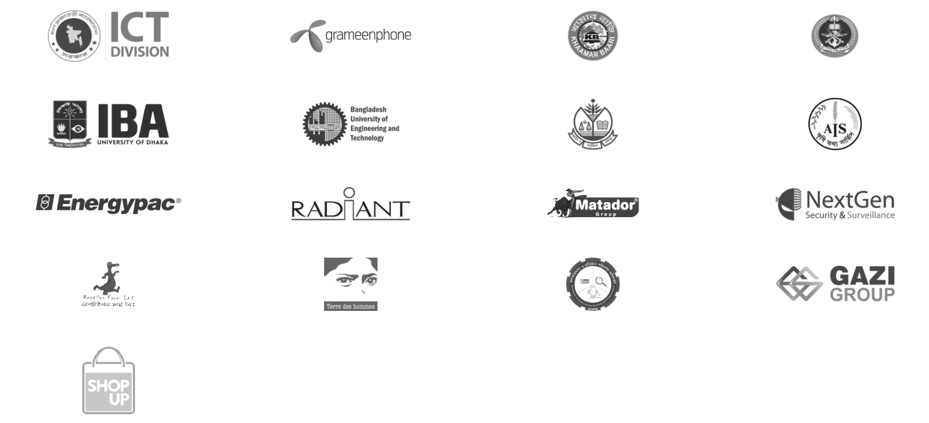
Featured Client

Slide 5
My Responsibilities
I am working as a full-stack web application developer in Inovace Technologies. I am responsible for implementing logic and creating API according to design and PRD(Project requirement document) using java (Spring boot) . Design and data integration using angularJs. I made some important features on inovace HRM(Human Resource Management) Application.

Slide 6
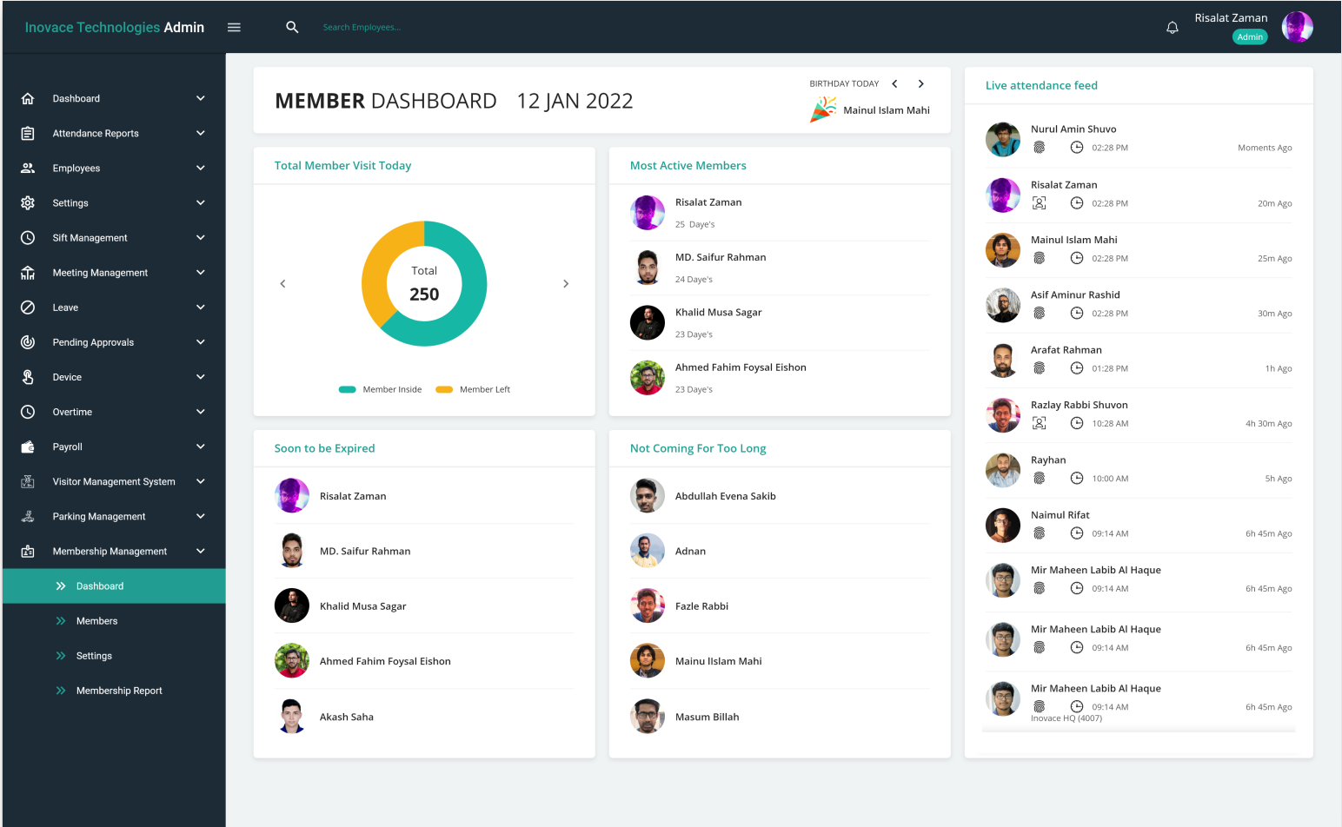
Some Graphical View of my work:
Membership management

Slide 7
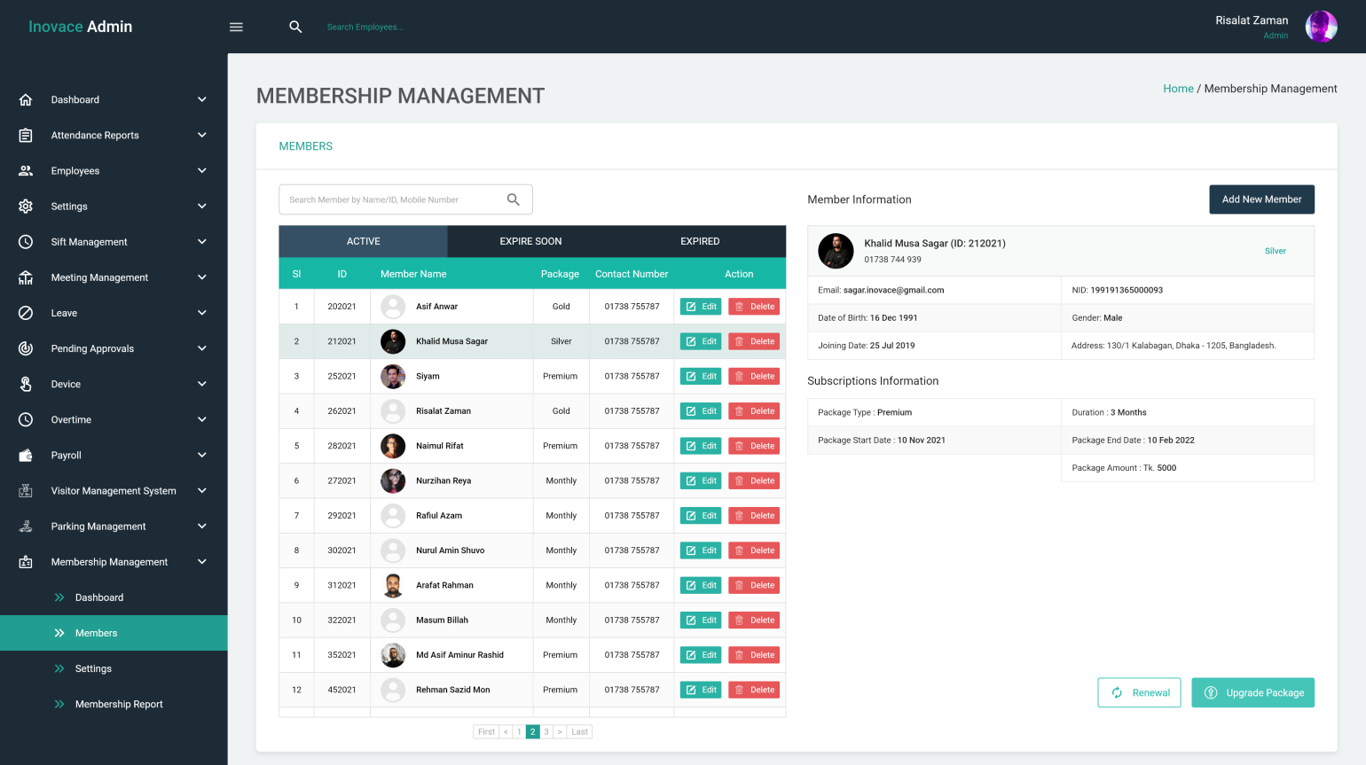

Slide 8
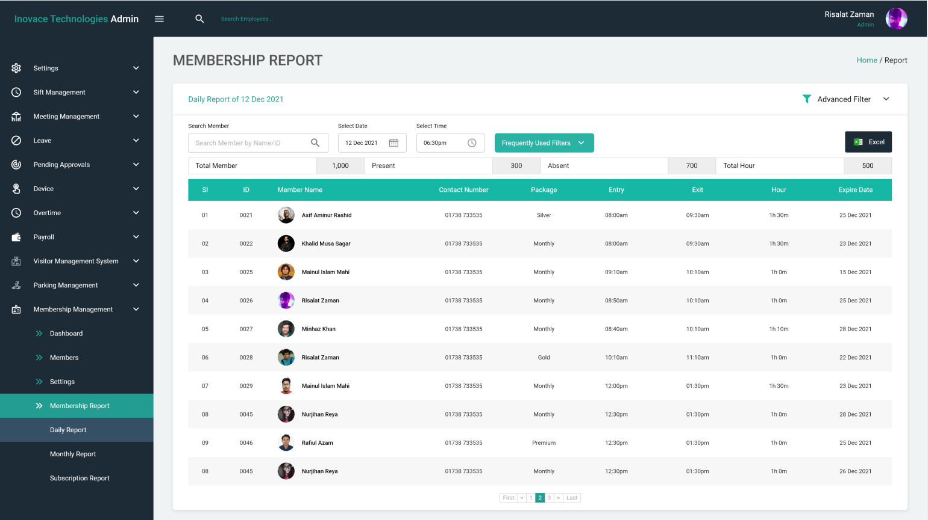

Slide 9
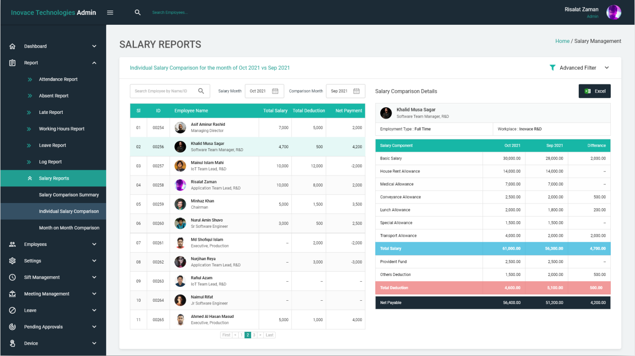
Part Of Payroll Management

Slide 10
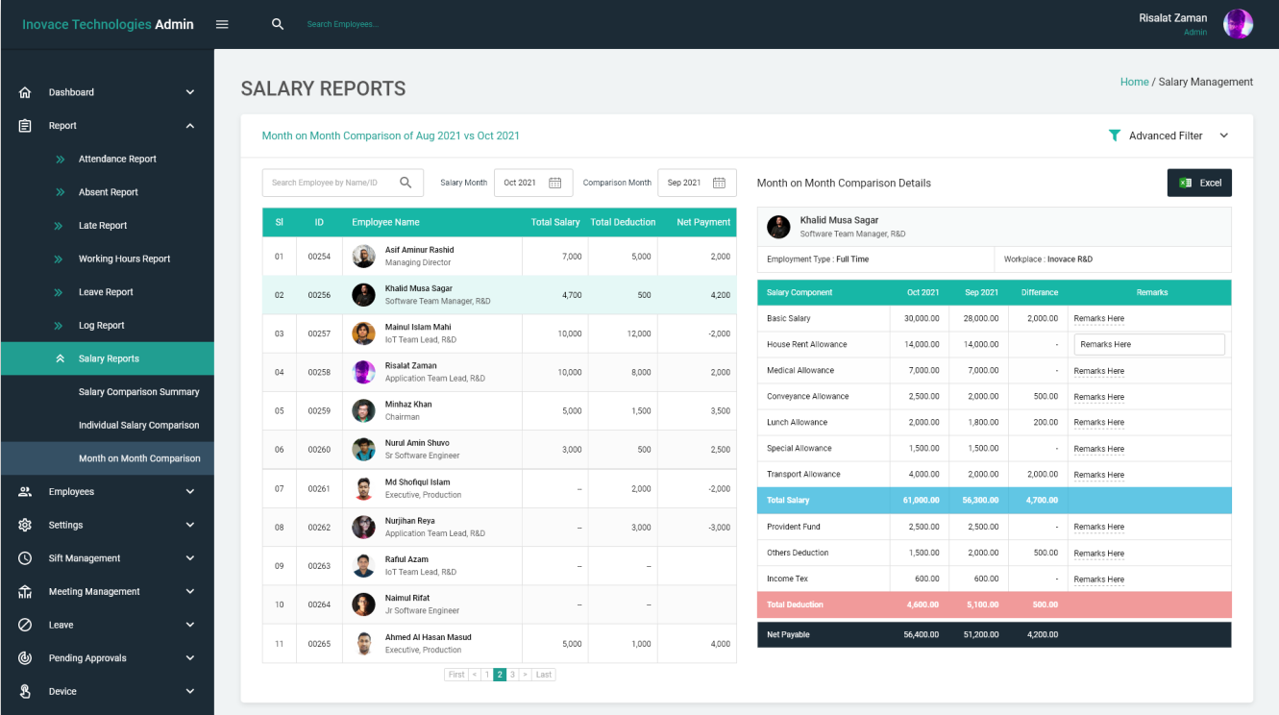

Slide 11
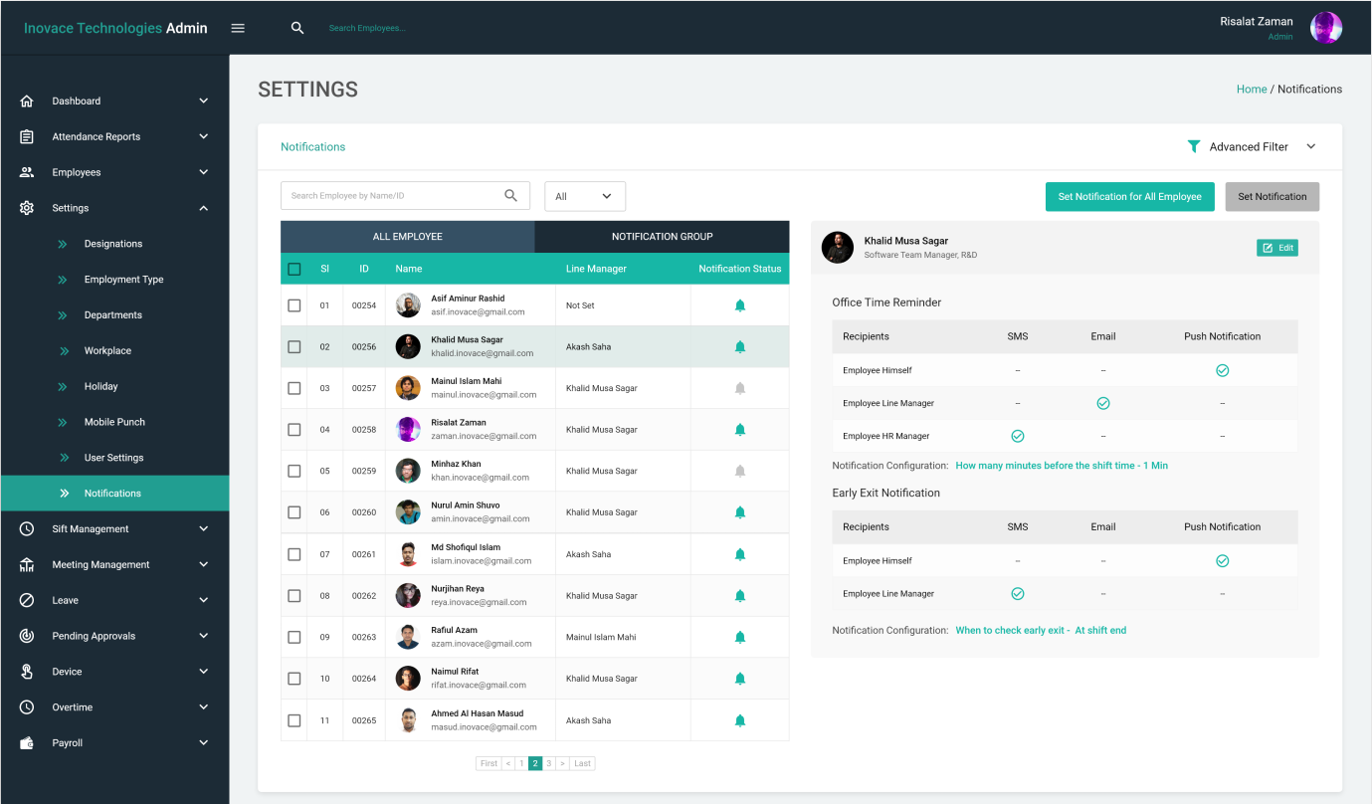
Notification Management

Slide 12
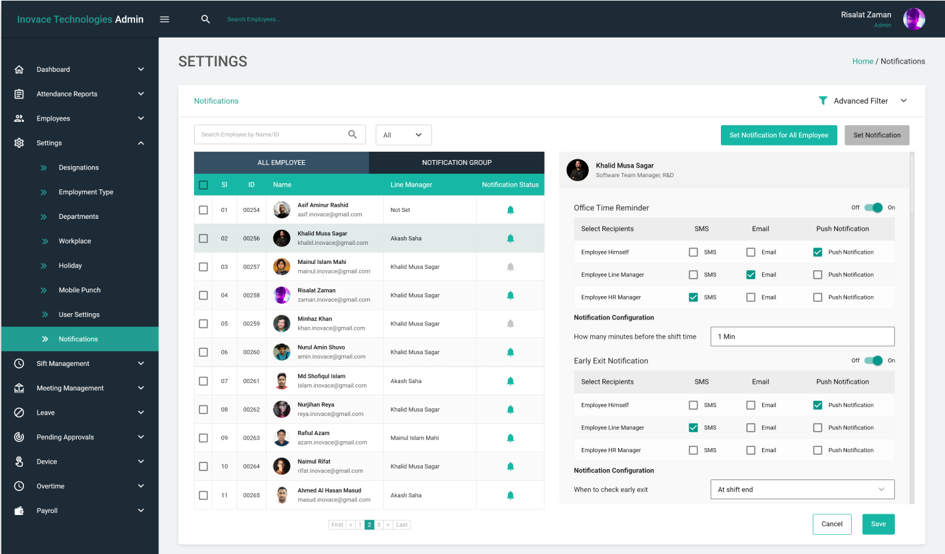

Slide 13
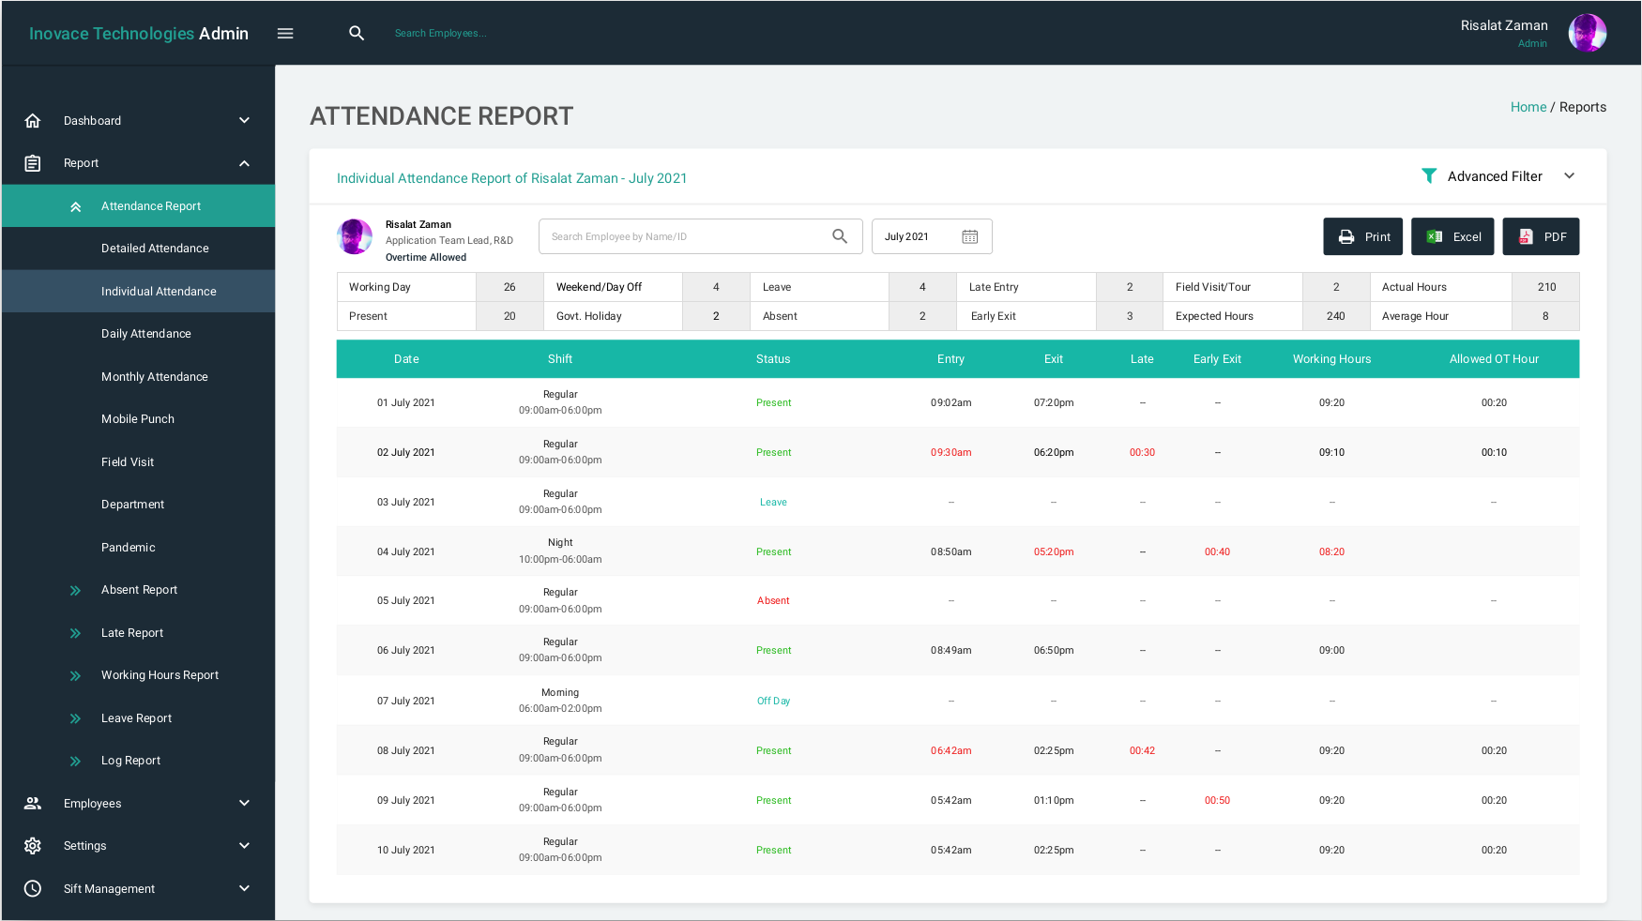
Attendance Report

Slide 14
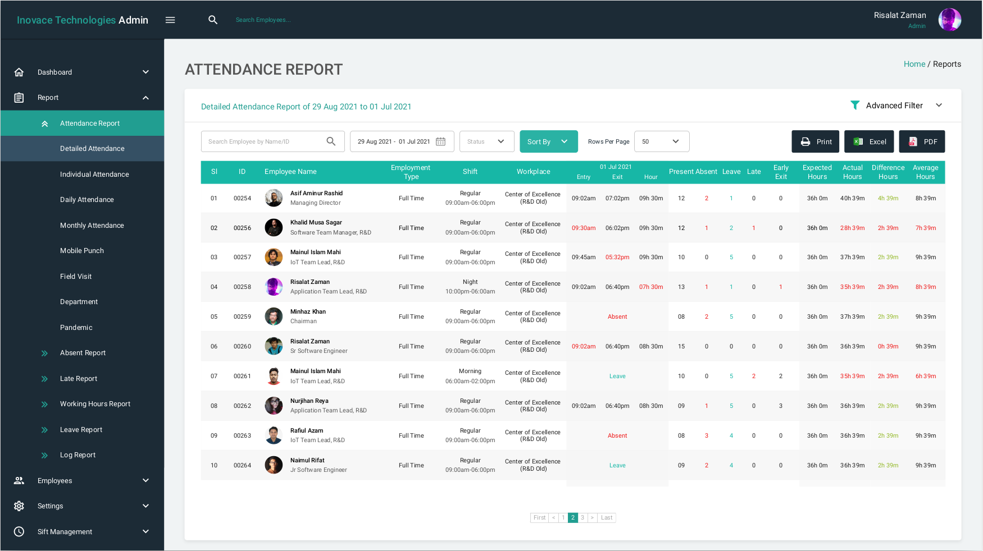

Slide 15
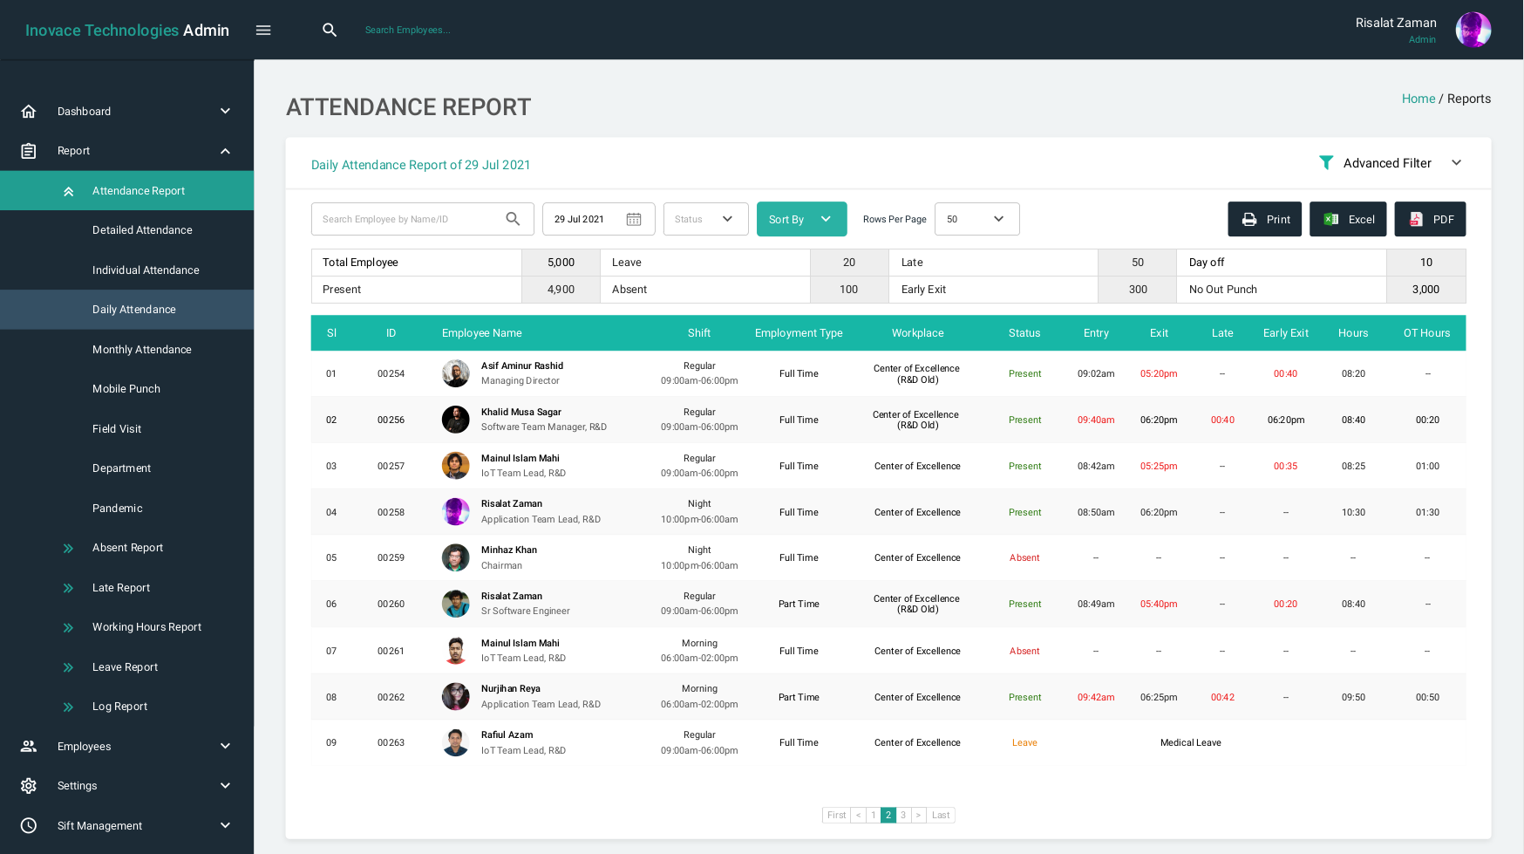

Slide 16
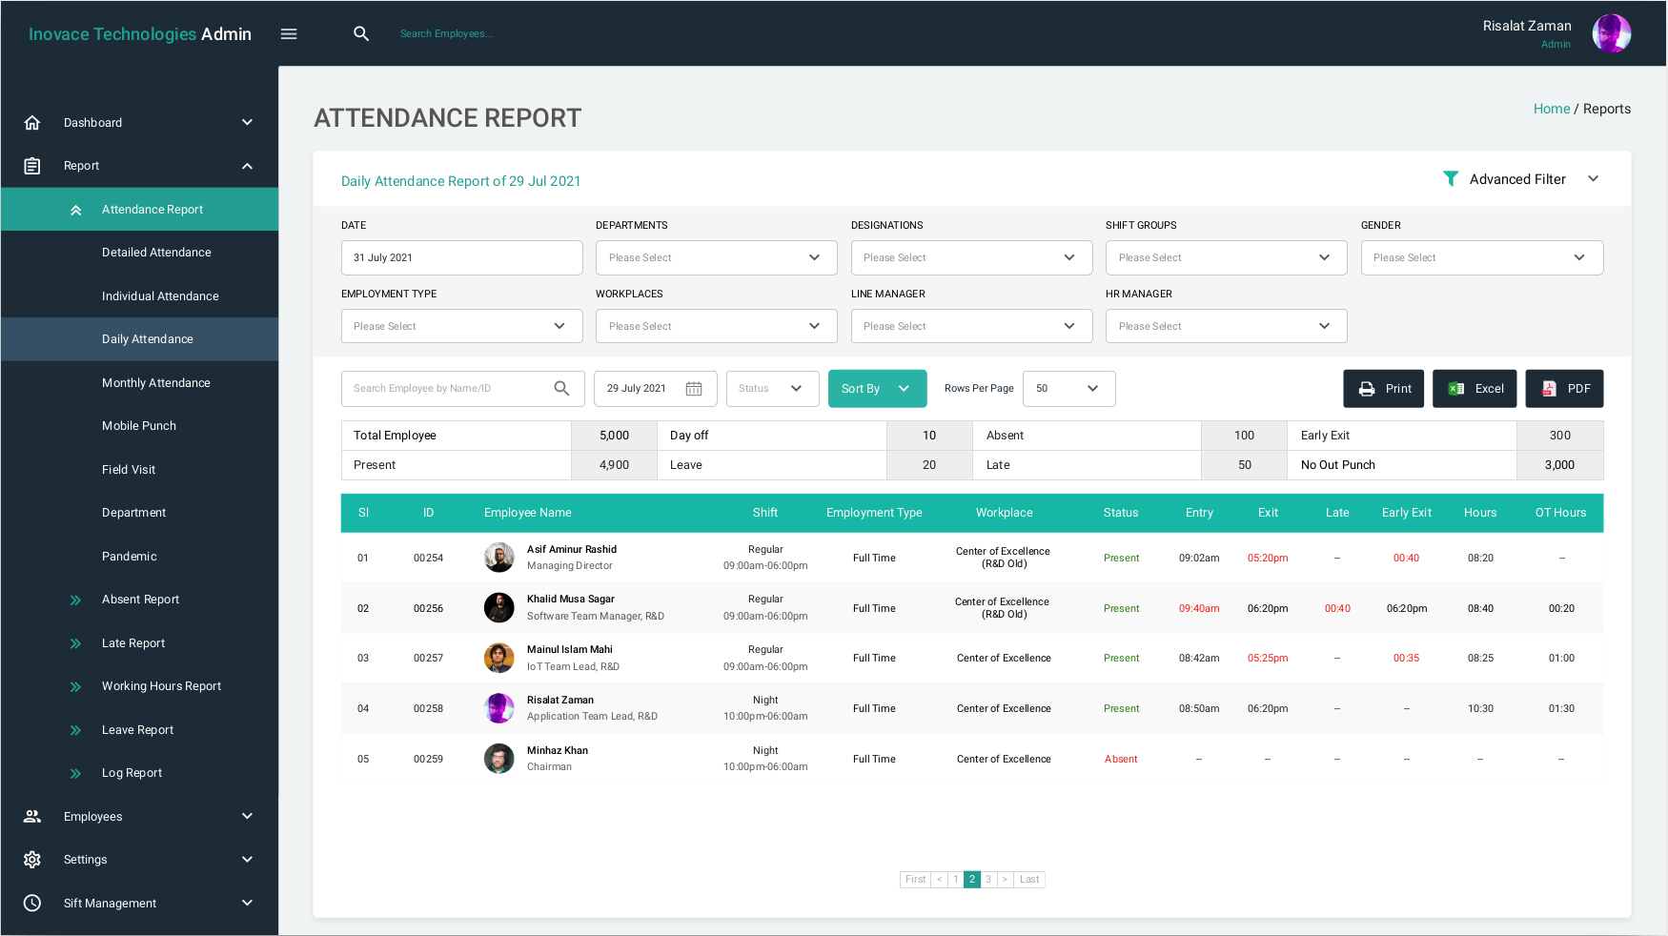

Slide 17
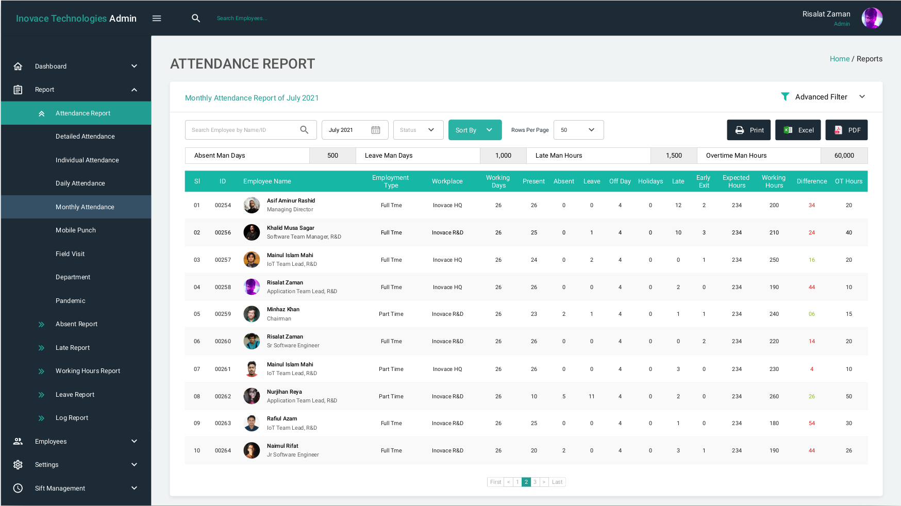

Slide 18
Learning Outcome
Learned more about java
Learned about Spring boot
Learned AngularJs.
practice of clean coding
trained me to finish the task properly at proper time
Improved working skill as a team member
Learned how to manage time

Slide 19
Thank You

